Slide 1

COMPUTER NETWORKS
(BCSC 0008)
DNS
Copyright content, use only with the written permission of presenter mentioned

Slide 2
Text and Reference Books
Text Books:
Fourouzan B. A. (2004), “Data Communication and Networking”, 4th Edition, McGraw-Hill.
References:
Kurose, J. F. and Ross K. W. (2005), “Computer Networking: A Top-Down Approach Featuring the Internet”, 3rd Edition, Addison-Wesley.
A. S. Tanenbaum (2006), “Computer Networks”, 2nd Edition, Prentice Hall India.

Slide 3
17.1 NAME SPACE
The names assigned to machines must be unique because the addresses are unique. A name space that maps each address to a unique name can be organized in two ways: flat or hierarchical.
The topics discussed in this section include:
Flat Name Space
Hierarchical Name Space

Slide 4
17.2 DOMAIN NAME SPACE
The domain name space is hierarchical in design. The names are defined in an inverted-tree structure with the root at the top. The tree can have 128 levels: level 0 (root) to level 127.
The topics discussed in this section include:
Label
Domain Name
Domain

Slide 5
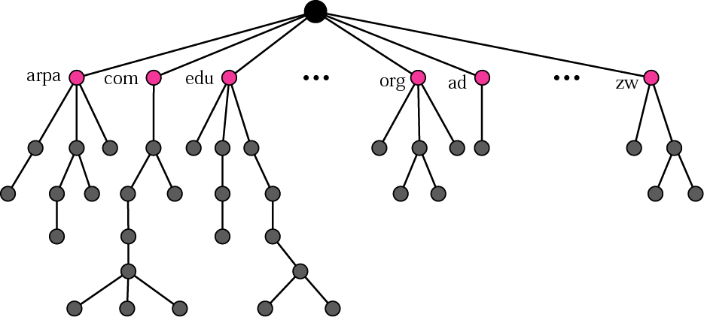
Figure 17.1 Domain name space

Slide 6
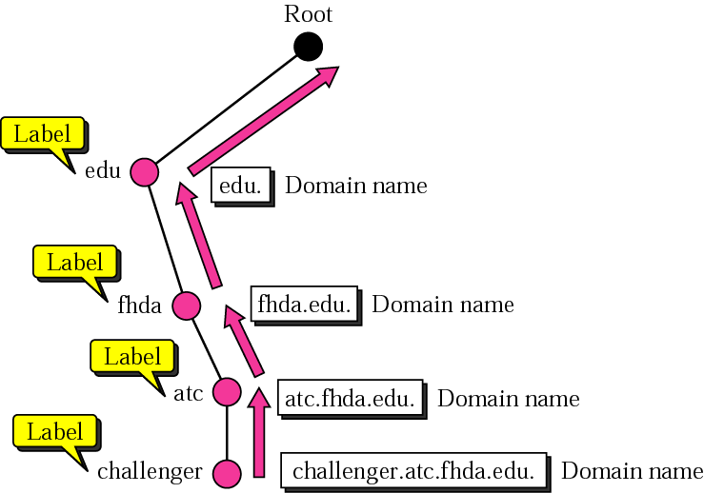
Figure 17.2 Domain names and labels

Slide 7
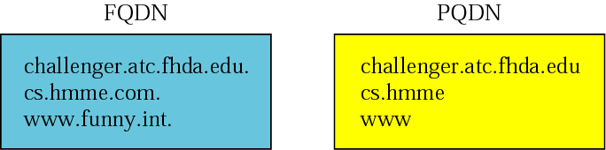
Figure 17.3 FQDN and PQDN

Slide 8
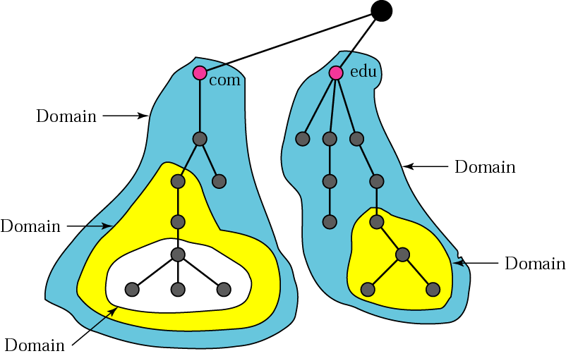
Figure 17.4 Domains

Slide 9
17.3 DISTRIBUTION OF
NAME SPACE
The information contained in the domain name space is distributed among many computers called DNS servers.
The topics discussed in this section include:
Hierarchy of Name Servers
Zone
Root Server
Primary and Secondary Servers

Slide 10
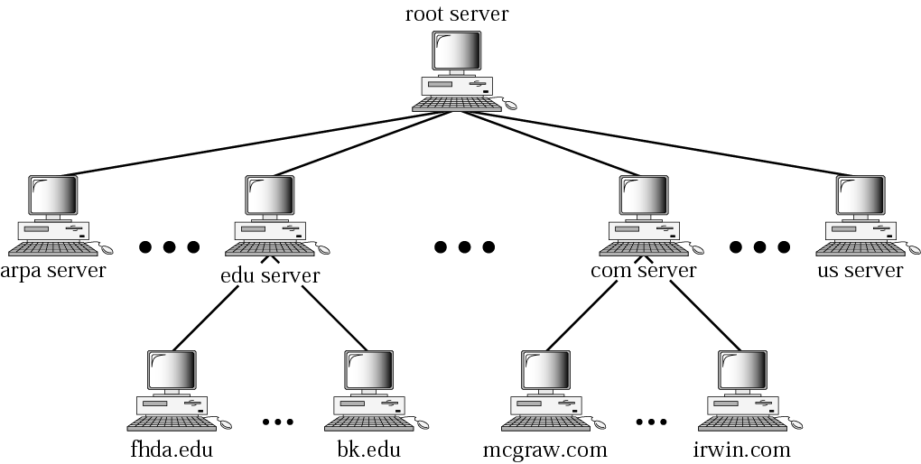
Figure 17.5 Hierarchy of name servers

Slide 11
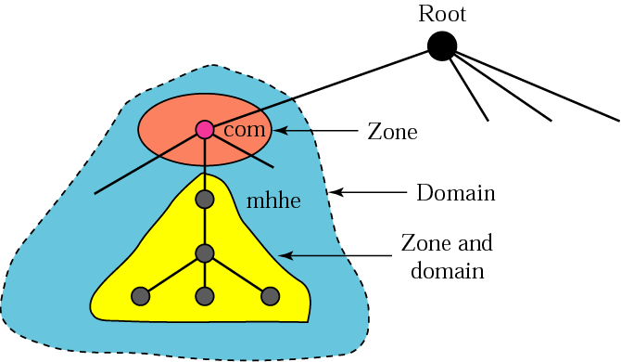
Figure 17.6 Zones and domains

Slide 12

Note:
A primary server loads all information from the disk file; the secondary server loads all information from the primary server. When the secondary downloads information from the primary, it is called zone transfer.

Slide 13
17.4 DNS IN THE INTERNET
The domain name space (tree) is divided into three different sections: generic domains, country domains, and the inverse domain.
The topics discussed in this section include:
Generic Domains
Country Domains
Inverse Domain
Registrar

Slide 14
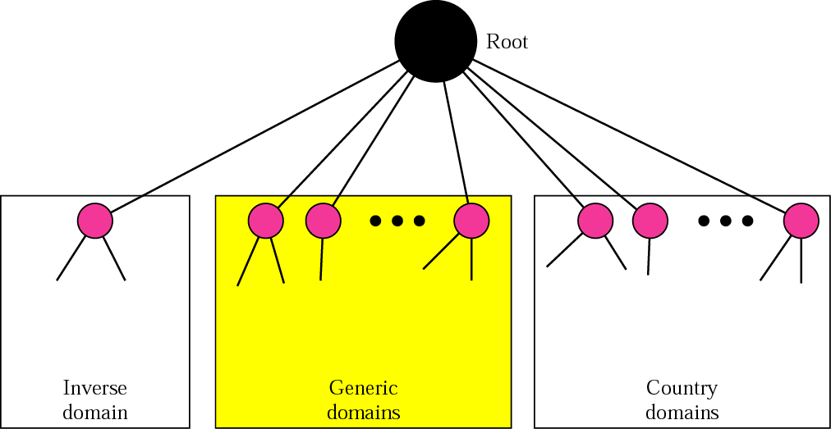
Figure 17.7 DNS used in the Internet

Slide 15
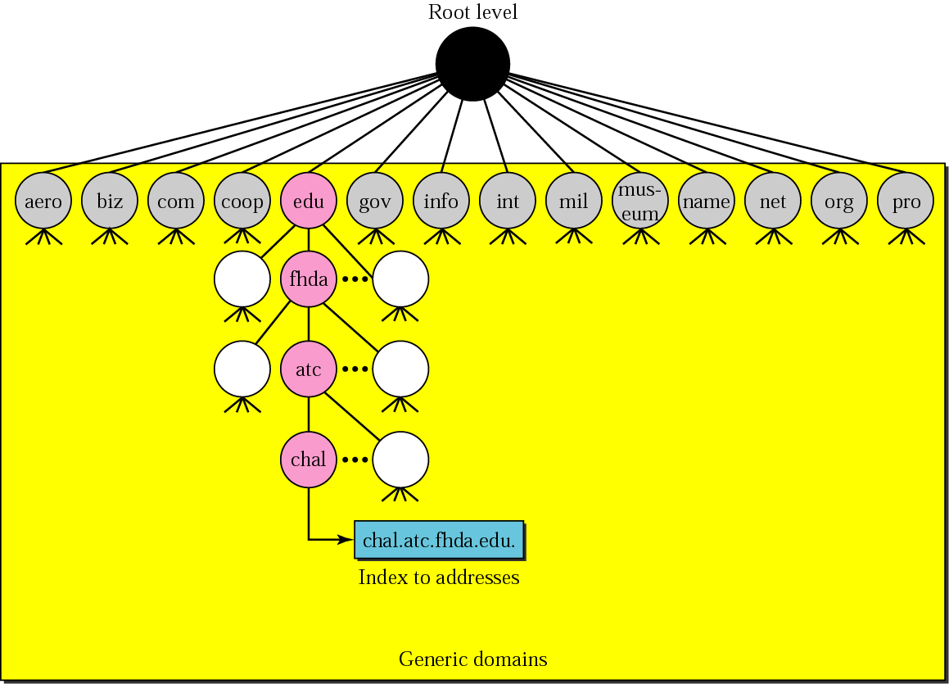
Figure 17.8 Generic domains

Slide 16
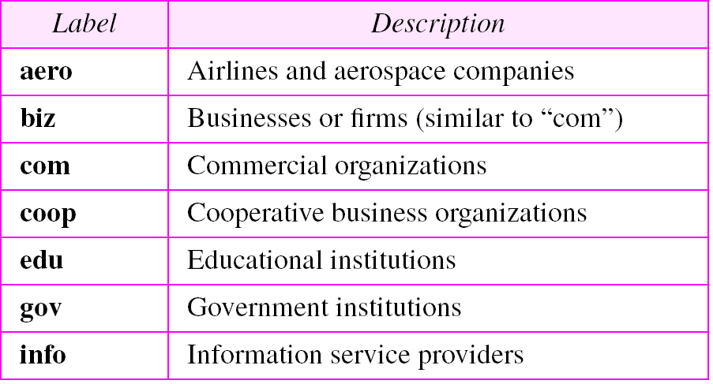
Table 17.1 Generic domain labels

Slide 17
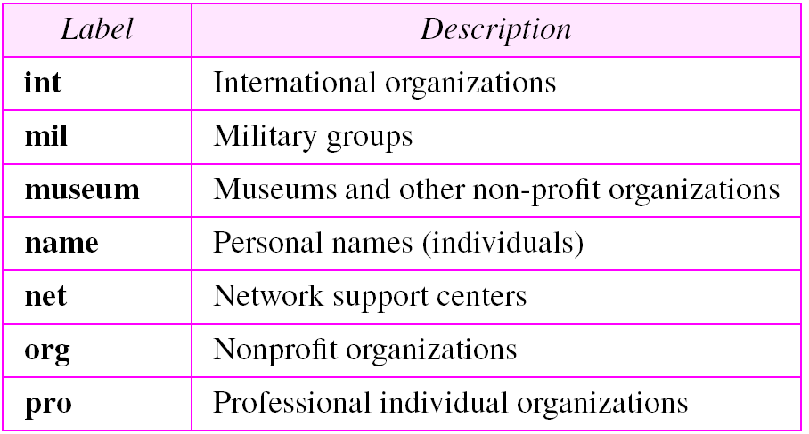
Table 17.1 Generic domain labels (Continued)

Slide 18
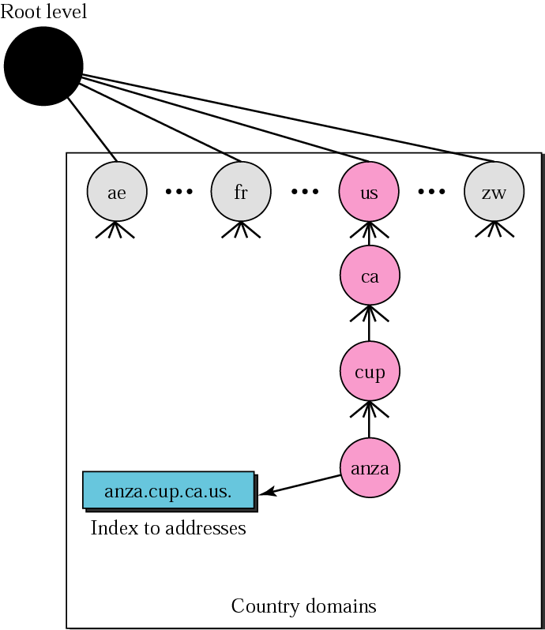
Figure 17.9 Country domains

Slide 19
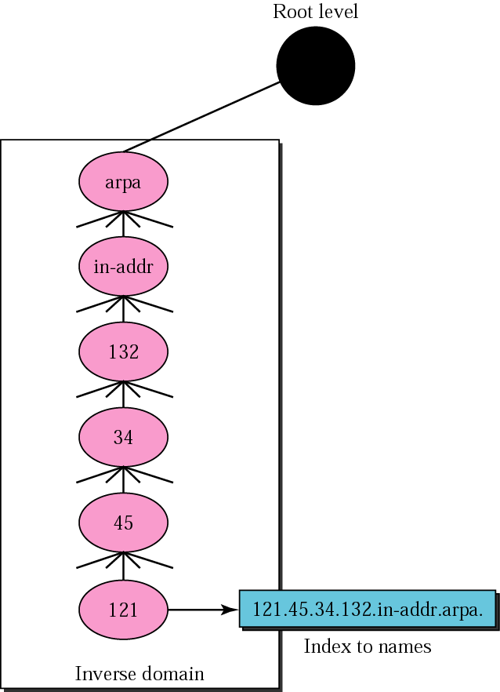
Figure 17.10 Inverse domain

Slide 20
17.5 RESOLUTION
Mapping a name to an address or an address to a name is called name-address resolution.
The topics discussed in this section include:
Resolver
Mapping Names to Addresses
Mapping Addresses to Names
Recursive Resolution
Iterative Resolution
Caching

Slide 21
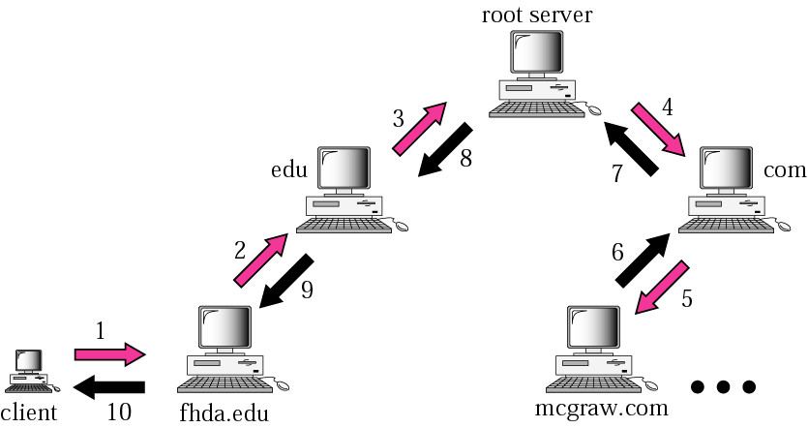
Figure 17.11 Recursive resolution

Slide 22
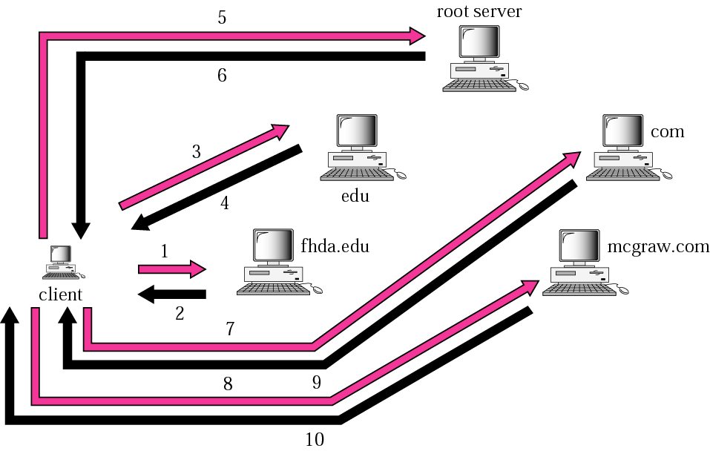
Figure 17.12 Iterative resolution

Slide 23
17.6 DNS MESSAGES
The DNS query message consists of a header and question records; the DNS response message consists of a header, question records, answer records, authoritative records, and additional records.
The topics discussed in this section include:
Header

Slide 24
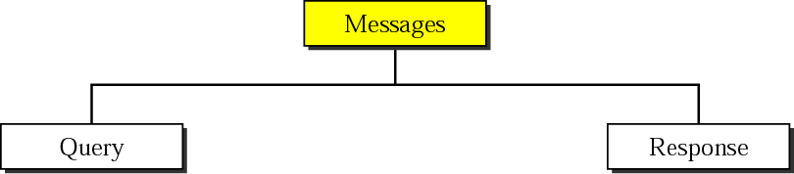
Figure 17.13 DNS messages

Slide 25
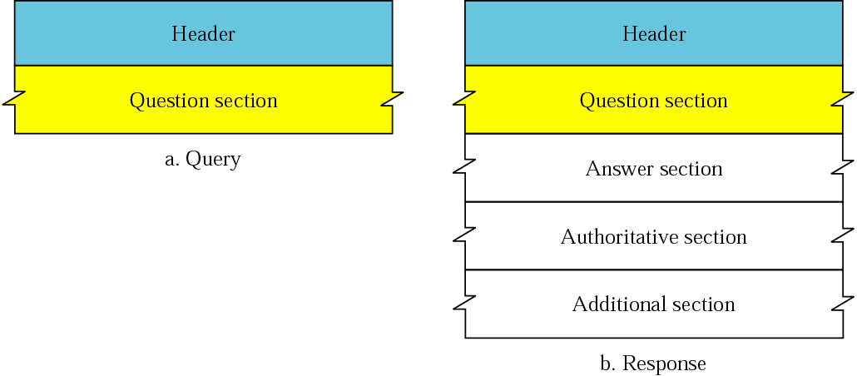
Figure 17.14 Query and response messages

Slide 26
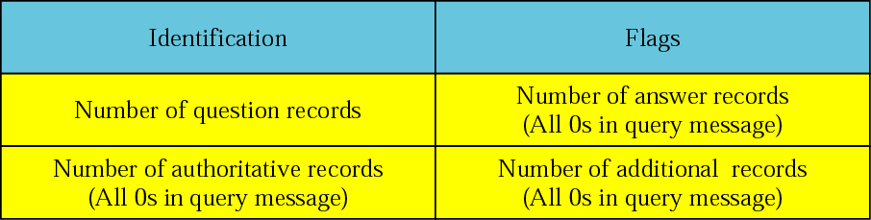
Figure 17.15 Header format

Slide 27
Figure 17.16 Flags field

Slide 28
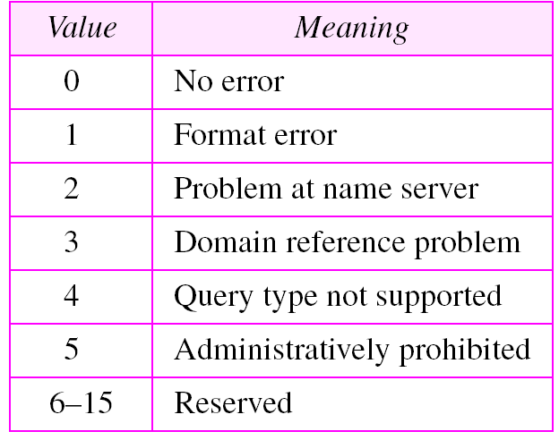
Table 17.2 Values of rCode

Slide 29
17.7 TYPES OF RECORDS
Two types of records are used in DNS. The question records are used in the question section of the query and response messages. The resource records are used in the answer, authoritative, and additional information sections of the response message.
The topics discussed in this section include:
Question Record
Resource Record

Slide 30
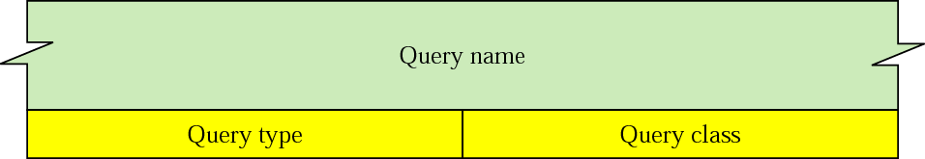
Figure 17.17 Question record format

Slide 31
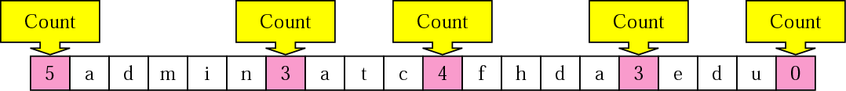
Figure 17.18 Query name format

Slide 32
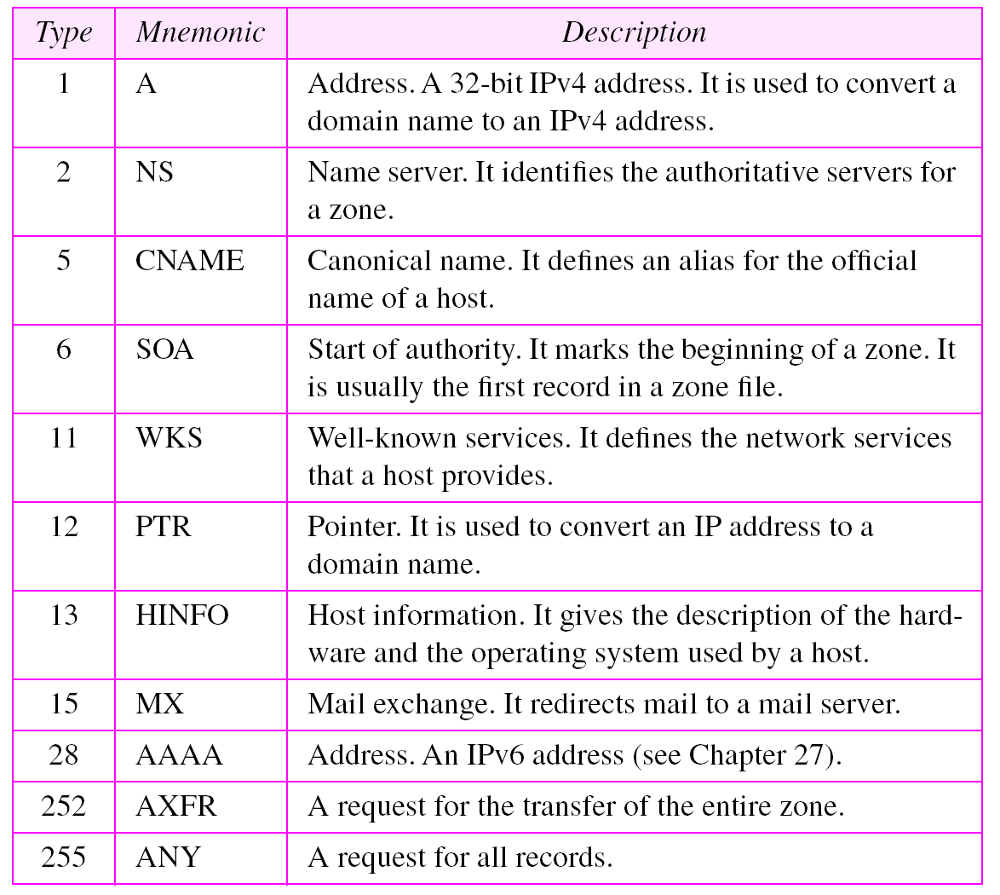
Table 17.3 Types

Slide 33
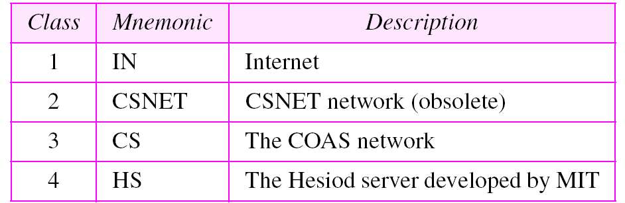
Table 17.4 Classes

Slide 34
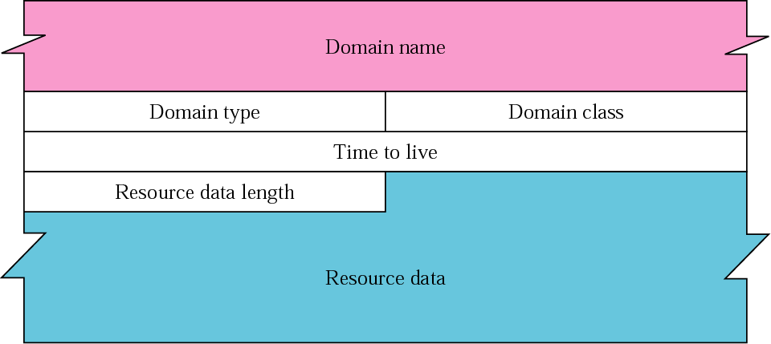
Figure 17.19 Resource record format

Slide 35
17.8 COMPRESSION
DNS requires that a domain name be replaced by an offset pointer if it is repeated. DNS defines a 2-byte offset pointer that points to a previous occurrence of the domain name or part of it.

Slide 36
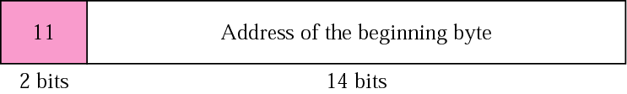
Figure 17.20 Format of an offset pointer

Slide 37
Example 1
A resolver sends a query message to a local server to find the IP address for the host “chal.fhda.edu.”. We discuss the query and response messages separately.
Figure 17.21 shows the query message sent by the resolver. The first 2 bytes show the identifier (1333). It is used as a sequence number and relates a response to a query. Because a resolver may even send many queries to the same server, the identifier helps to sort responses that arrive out of order. The next bytes contain the flags with the value of 0x0100 in hexadecimal. In binary it is 0000000100000000, but it is more meaningful to divide it into the fields as shown below:
QR OpCode AA TC RD RA Reserved rCode
0 0000 0 0 1 0 000 0000

Slide 38
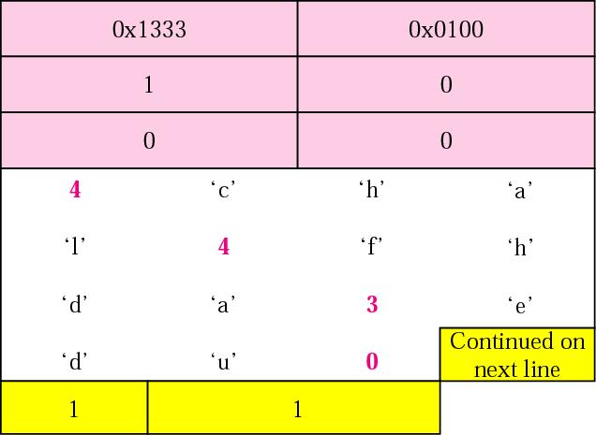
Figure 17.21 Example 1: Query message

Slide 39
Example 1 (Continued)
The QR bit defines the message as a query. The OpCode is 0000, which defines a standard query. The recursion desired (RD) bit is set. (Refer back to Figure 17.16 for the flags field descriptions.) The message contains only one question record. The domain name is 4chal4fhda3edu0. The next 2 bytes define the query type as an IP address; the last 2 bytes define the class as the Internet.
Figure 17.22 shows the response of the server. The response is similar to the query except that the flags are different and the number of answer records is one. The flags value is 0x8180 in hexadecimal. In binary it is 1000000110000000, but again we divide it into fields as shown below:
QR OpCode AA TC RD RA Reserved rCode
1 0000 0 0 1 1 000 0000

Slide 40
Example 1 (Continued)
The QR bit defines the message as a response. The OpCode is 0000, which defines a standard response. The recursion available (RA) and RD bits are set. The message contains one question record and one answer record. The question record is repeated from the query message. The answer record has a value of 0xC00C (split in two lines), which points to the question record instead of repeating the domain name. The next field defines the domain type (address). The field after that defines the class (Internet). The field with the value 12,000 is the TTL (12,000 s). The next field is the length of the resource data, which is an IP address (153.18.8.105).

Slide 41
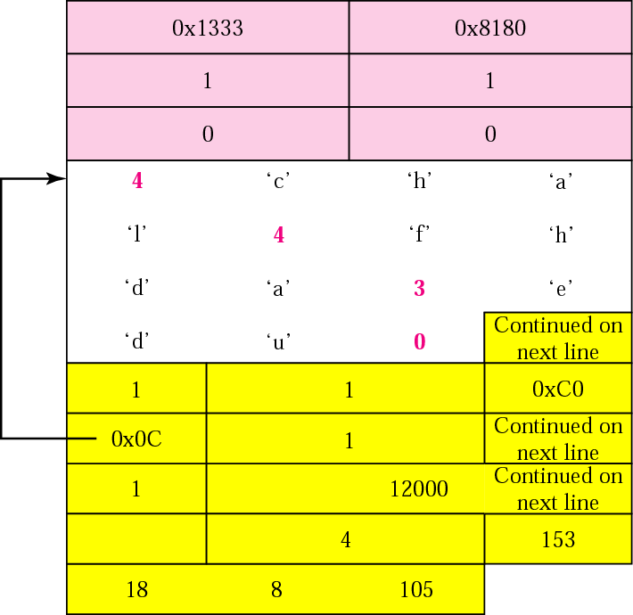
Figure 17.22 Example 1: Response message

Slide 42
Example 2
An FTP server has received a packet from an FTP client with IP address 153.2.7.9. The FTP server wants to verify that the FTP client is an authorized client. The FTP server can consult a file containing the list of authorized clients. However, the file consists only of domain names. The FTP server has only the IP address of the requesting client, which was the source IP address in the received IP datagram. The FTP server asks the resolver (DNS client) to send an inverse query to a DNS server to ask for the name of the FTP client. We discuss the query and response messages separately.

Slide 43
Example 2 (Continued)
Figure 17.23 shows the query message sent from the resolver to the server. The first 2 bytes show the identifier (0x1200). The flags value is 0x0900 in hexadecimal. In binary it is 0000100100000000, and we divide it into fields
as shown below:
QR OpCode AA TC RD RA Reserved rCode
0 0001 0 0 1 0 000 0000
The OpCode is 0001, which defines an inverse query. The message contains only one question record. The domain name is 19171231537in-addr4arpa. The next 2 bytes define the query type as PTR, and the last 2 bytes define the class as the Internet.

Slide 44
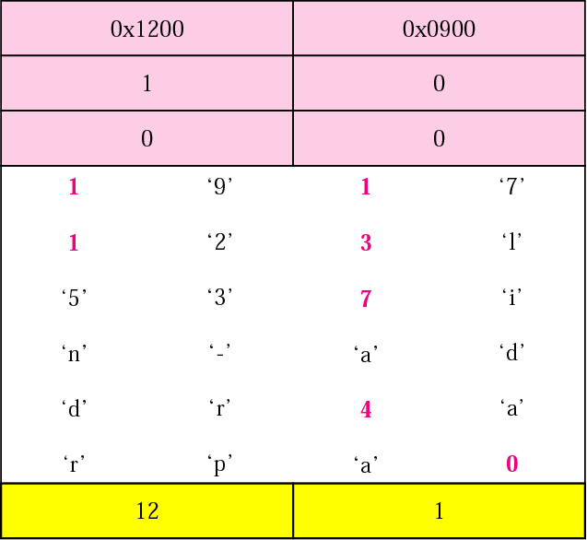
Figure 17.23 Example 2: Inverse query message

Slide 45
Example 2 (Continued)
Figure 17.24 shows the response. The flags value is 0x8D80 in hexadecimal. In binary it is 1000110110000000, and we divide it into fields as shown below:
QR OpCode AA TC RD RA Reserved rCode
1 0001 1 0 1 1 000 0000

Slide 46
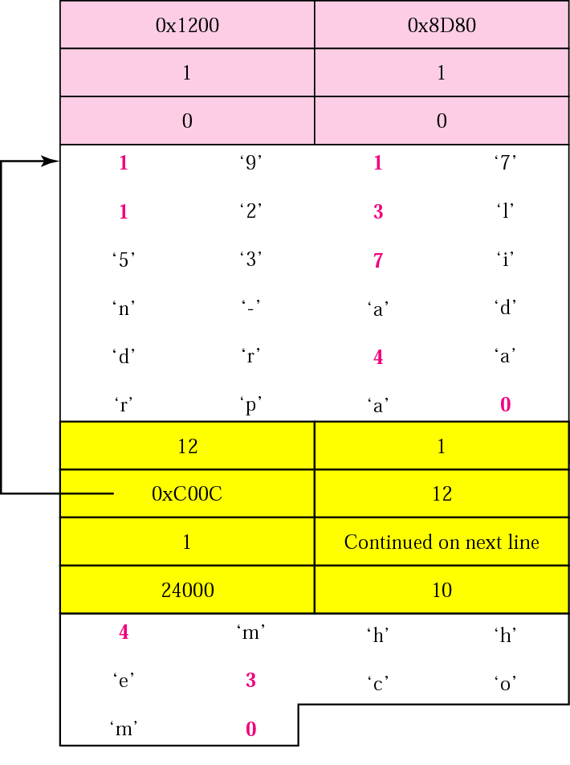
Figure 17.24 Example 2: Inverse response message

Slide 47
Example 3
In UNIX and Windows, the nslookup utility can be used to retrieve address/name mapping. The following shows how we can retrieve an address when the domain name is given.
$ nslookup fhda.edu
Name: fhda.edu
Address: 153.18.8.1
The nslookup utility can also be used to retrieve the domain name when the address is given as shown below:
$ nslookup 153.18.8.1
1.8.18.153.in-addr.arpa name = tiptoe.fhda.edu.

Slide 48
17.9 DDNS
The Dynamic Domain Name System (DDNS) updates the DNS master file dynamically.

Slide 49
17.10 ENCAPSULATION
DNS uses UDP as the transport protocol when the size of the response message is less than 512 bytes. If the size of the response message is more than 512 bytes, a TCP connection is used.

Slide 50
Note:
DNS can use the services of UDP or TCP using the well-known port 53.

